Slide 1
Machine Learning Identification and Predictions of Gentrification in Nashville, TN.
David Knorr
Vanderbilt Institute for Smart Cities Operation and Research
Notes:
I want to begin by pointing out the contradictions in the title slide. And those are the two underlined words there. I can’t think of anything as impersonal as machine learning and on the other hand we have gentrification which can be deeply personal with long lasting effects. Application of ML is insightful in the context of gentrification. The last contradiction that I want to acknowledge is that I haven’t experienced this phenomenon directly. And I imagine that many in the audience haven’t either.
And if you haven’t experienced it maybe you can imagine your childhood home, or maybe your current home. Any place where you lived, worked, or played. Now imagine that you’re no longer welcome there. On top of that, developers are going to tear down your home intentionally or unintentionally removing your sense of place. You no longer belong in your home.
And so I’ll begin by proposing a solution architect Liz Ogbu
“The first step requires courage, the courage to see each others pain and to be willing to stay in the presence of it, even when it gets uncomfortable”

Slide 2
“Gentrification is a frontier not just physically, economically, socially and culturally, but also theoretically, ideologically, and politically. It comprises a contested boundary zone between radically different theories and explanations.
(Hammet, 1991)
Notes:
With that said I hope we can all approach this subject with a lot of respect because it is a truly fascinating interdisciplinary research topic. David Hammet said in 1991 that “Gentrification is a frontier not just physically, economically, socially and culturally, but also theoretically, ideologically, and politically. It comprises a contested boundary zone between radically different theories and explanations.
So there is enough capacity in this problem for everyone in the room with different research areas to contribute to. That may be thinking about the problem in an ecological perspective, or in the lense of migratory work that Kelsea focuses on, or links to climate science if we frame the problem of gentrification as a negative externality much like CO2 emissions.

Slide 3
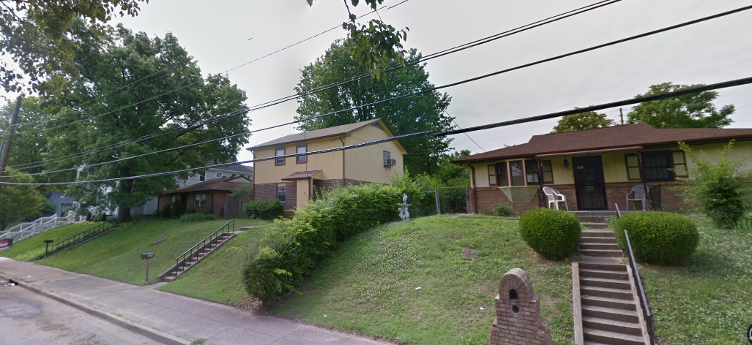
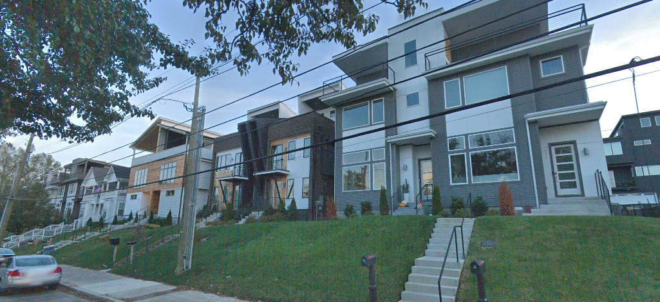
June 2016
South Street
Nations
November 2018

Slide 4
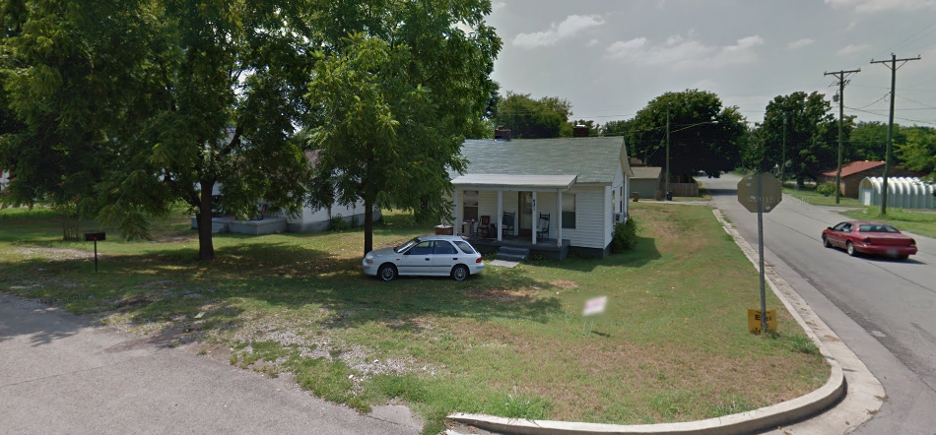
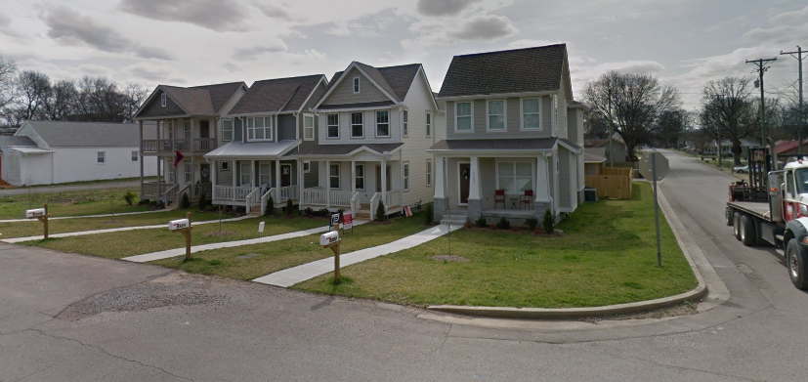
August 2011
Pennsylvania Ave
Nations
May 2016

Slide 5
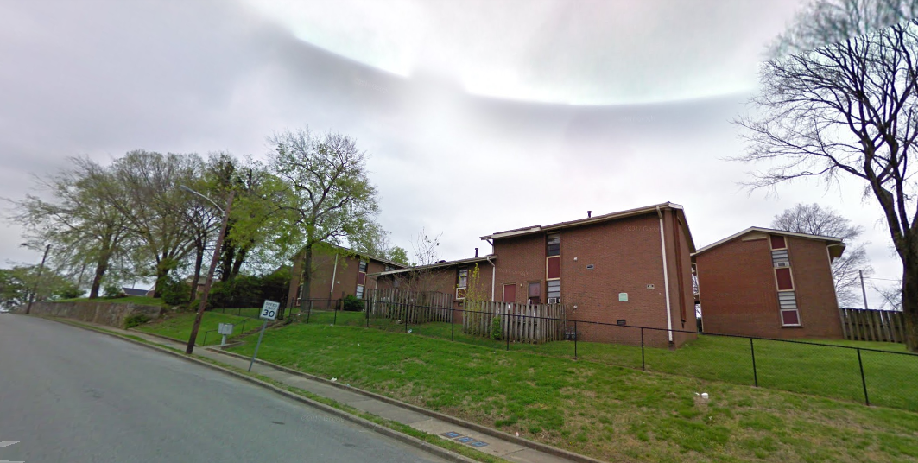
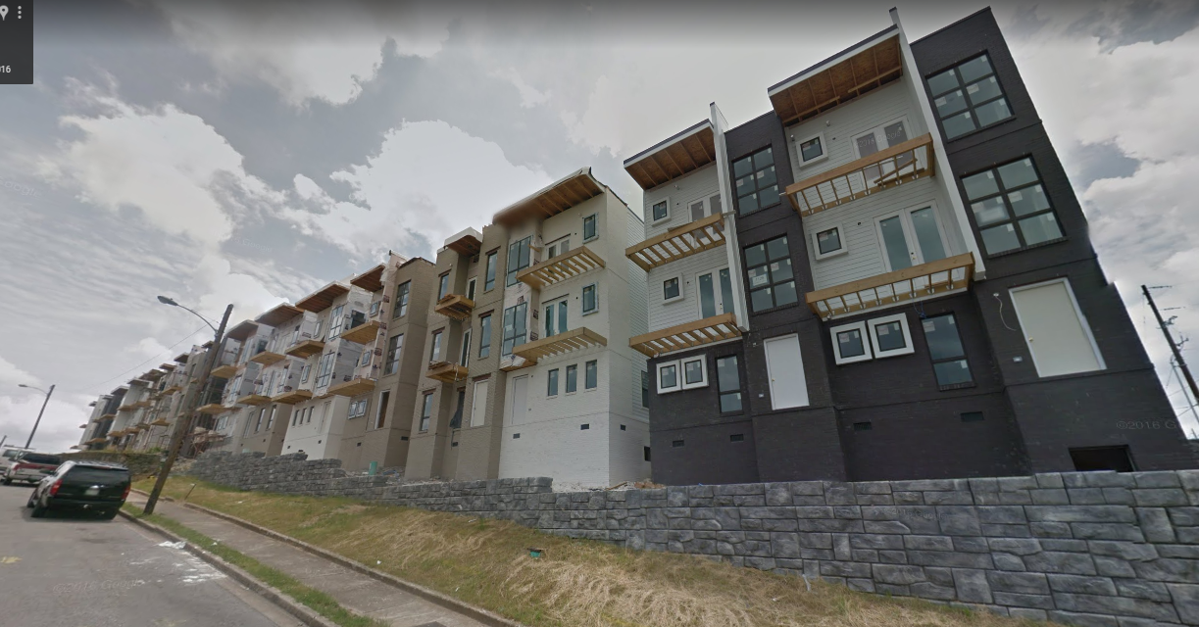
April 2009
Archer Street
Edgehill
June 2016

Slide 6
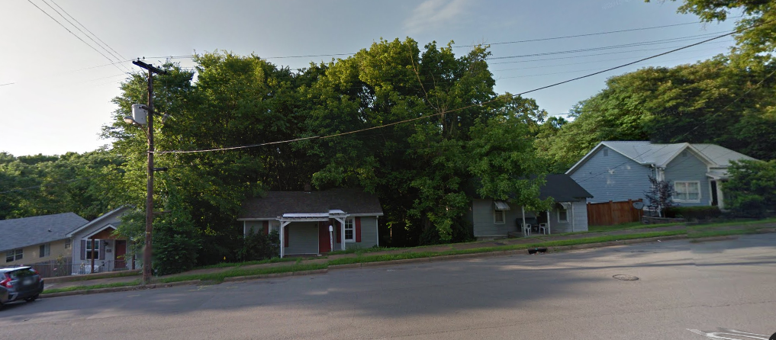
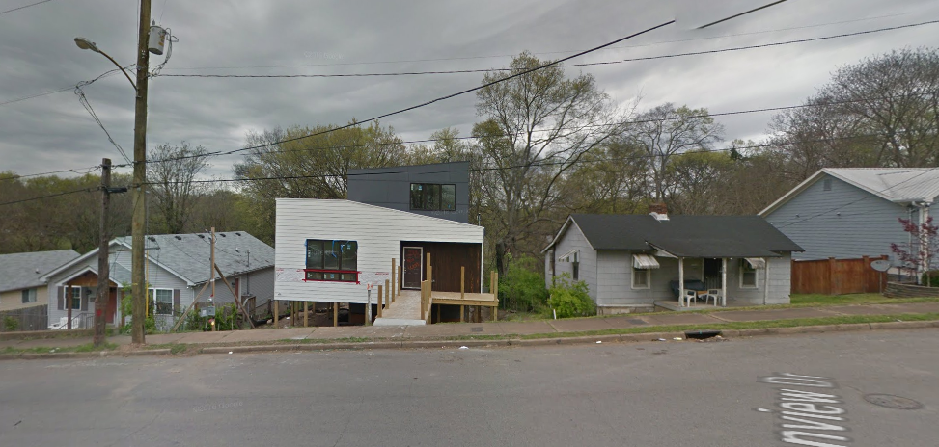
June 2016
Glenview Dr.
East Nashville
March 2017

Slide 7
Goals
Develop a reliable method to quantitatively distinguish gentrification from other types of neighborhood change.
Build a predictive model to identify at-risk areas of future gentrification in Nashville, TN.
Notes:
For those that are unfortunate enough to experience gentrification, displacement, and exclusion, I imagine that you probably don’t need a machine learning algorithm to identify it for them when they look down their street. On the other hand if you’re a high-level decision maker with limited time and resources, I do deeply believe that the first critical step is correctly defining and identifying the problem. So that will be a reoccurring theme throughout my presentation.
And I will spend some time to explain where these quantitative definitions stray from their intended target and the need for a better method.

Slide 8
GENTRIFICATION
EQUITABLE DEVELOPMENT
The redevelopment of a working-class neighborhood that results in the displacement of low-income populations.
The redevelopment of urban neighborhoods that improves the quality of life for residents of all incomes by maintaining and building affordable housing.

Slide 9
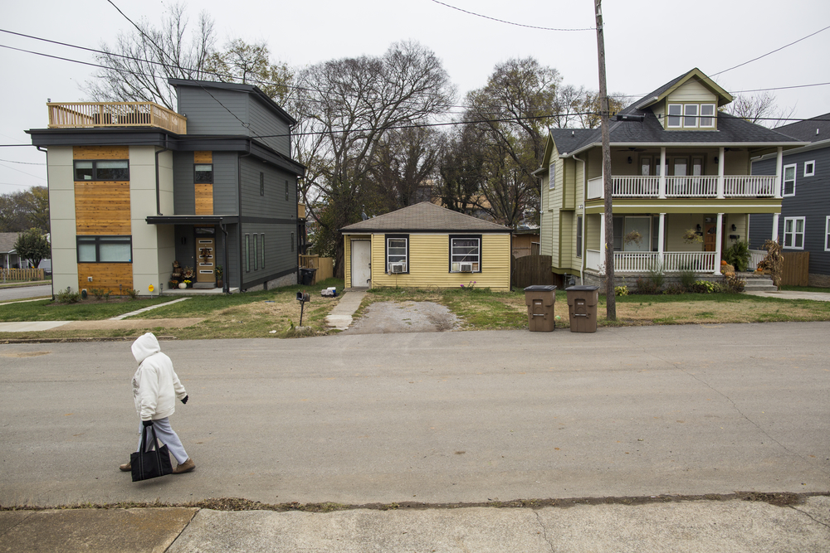
Displacement
Financial
Social
Exclusionary

Slide 10
Motivation
”If one wants to better understand, predict and even alter changes in urban neighborhoods, one thus must be exceedingly careful in operationally specifying the exact dynamic in question, and must recognize that such a specification may, in itself, influence the outcome of the analysis.”
(Galster and Peacock, 1985)

Slide 11
Quantitative Definitions of Gentrification
Author | Extent | Spatial Unit | Time Period | Eligibility Criteria | Gentrification Criteria
Chapple (2009) | San Francisco | Census Tracts | 1990-2000 | Below 40% of regional household income. | Median Home Value Appreciation above regional average; Increase in educational attainment above regional average.
Hammel and Wyly (1996) | 50 largest US Metropolitan Statistical Areas | Census Tracts | 1960 - 1990 (Deccenial) | Below 50% of city-wide median income. | Above 50% city-wide median income.
Freeman (2005) | National | Census Tracts | 1980 - 2000 (Deccenial) | Median income less than city median; proportion of housing built within last 20 years less than city median. | Increase in educational attainment greater than city median; Increase in real housing prices during each intercensal period.
Martin (2019) | National | Census Blocks | 1970 - 2010 (Deccenial) | Average HH income less than 80% of city-wide average income. | Increase in average household income by at least 25% median average household income (weak gentrification) or 50% (strong gentrification)
Ellen and Ding (2016) | National | Census Tracts | 1980 -2010 (Deccenial) | Average family Income below 40th percentile of metro average | At least a 10-percentage-point increase in the tract-to-metro ratio of 1) average family income, 2) share of white residents, 3) share of college-educated residents, or 4) median rent

Slide 12

49%
49%
Base Year
&
= Eligible
Eligible
Ineligible
Eligible
Ineligible
Household Income
New Housing
51%
&
= Gentrified
+$1
$↑
Not Gentrifying
Gentrifying
Real Housing Price Increase
Δ Educational Attainment

Slide 13
Base Year
&
= Eligible
1%
1%
Eligible
Ineligible
Eligible
Ineligible
Household Income
New Housing
49%
&
= Not
Gentrified
x3 $
$↑↑↑
Not Gentrifying
Gentrifying
Real Housing Price Increase
Δ Educational Attainment

Slide 14
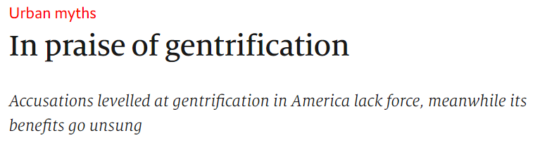
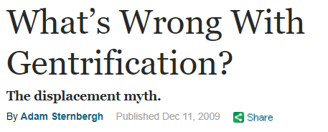
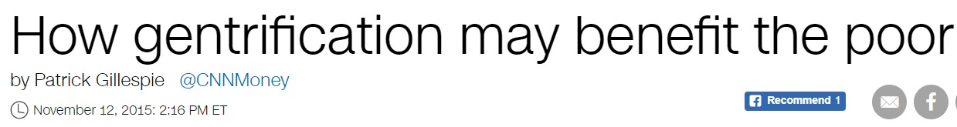

Slide 15
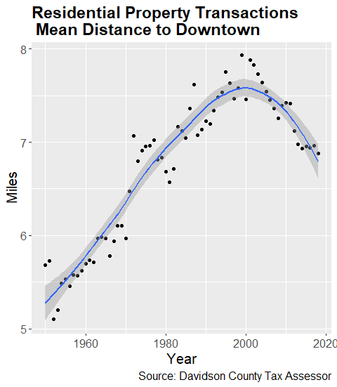
Methods
Time Period
Spatial Units
Input Variables
Clustering Algorithm
Sensitivity
Interpretation
Spatial Significance
Predictive Variables
Model Selection
Tuning
Performance
Predictions
Identifying Gentrification
Predicting Gentrification

Slide 16
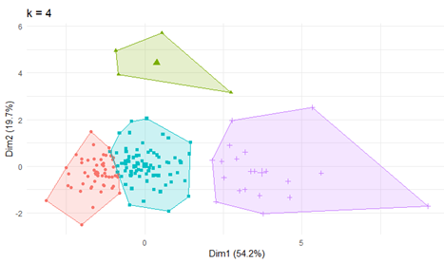
Clustering Neighborhood Change Typologies
K-means clustering: unsupervised machine learning
User specified k number of clusters.
Iteratively adjust centroid to minimize within-cluster sum of squares distance.
Input Variables (percent change from 2000 – 2016)
Median Home Value
Median Rent Value
Median Household Income
Percentage of persons 25+ with college degree
Percent Non-White
Percent Multi-unit housing

Slide 17
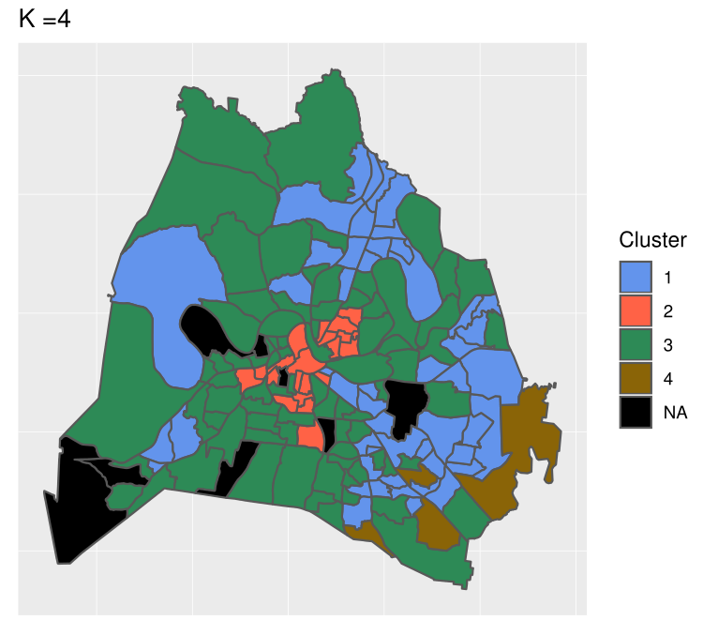
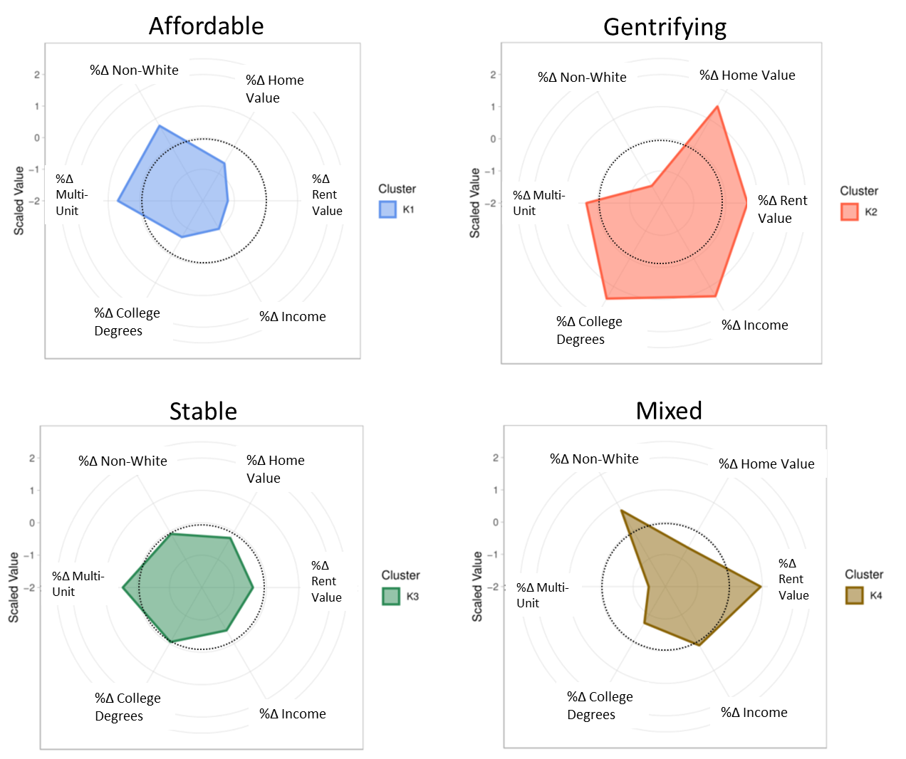
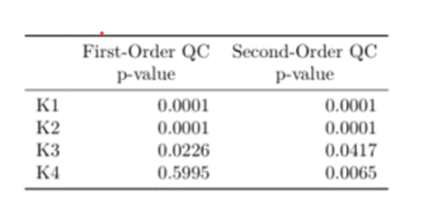
K1
K2
K3
K4
NA

Slide 18
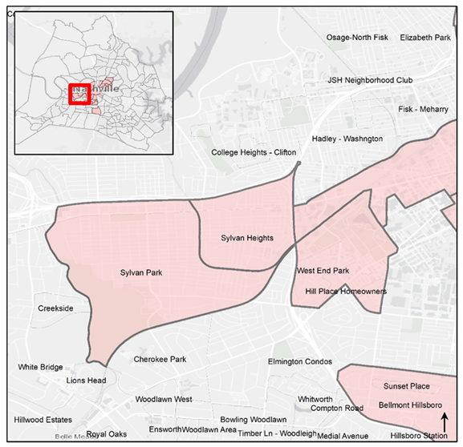
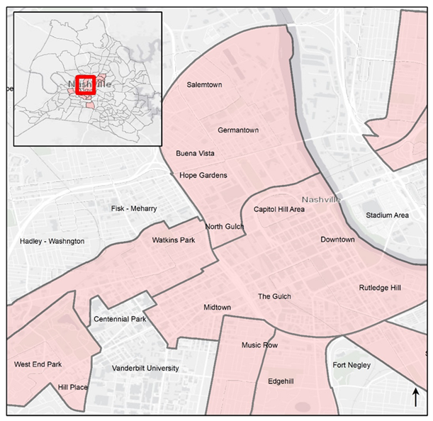
West Nashville
Central Nashville

Slide 19
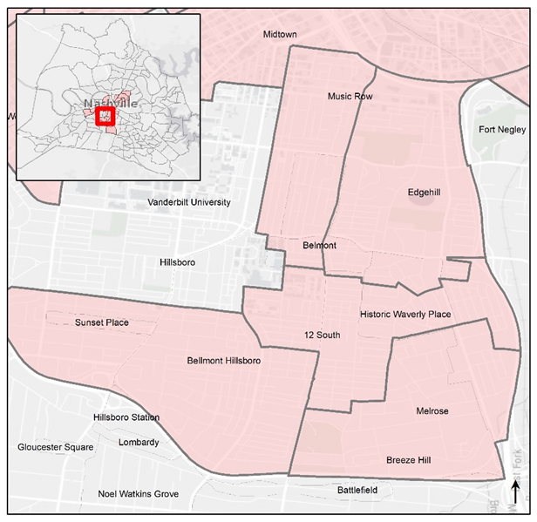
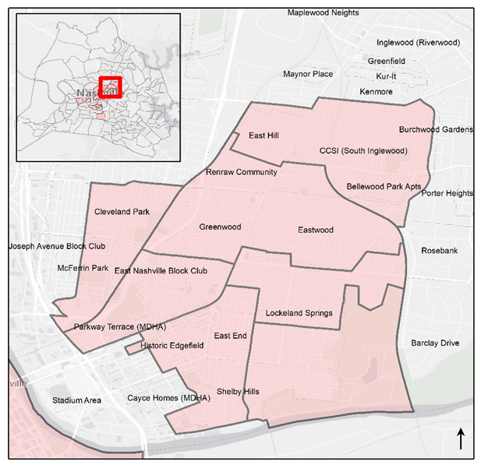
Southern Nashville
East Nashville

Slide 20
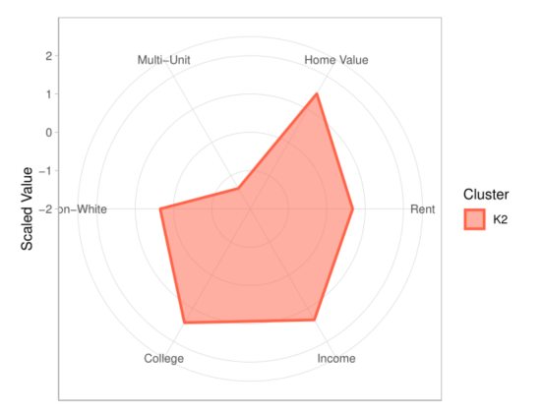
Goal 1
Develop a reliable method to quantitatively distinguish gentrification from other types of neighborhood change.
K-means clustering of six change variables.
No a priori assumption of gentrification.
No arbitrary thresholds.
Holistic view of city-specific typologies of neighborhood change.
Stable identification of gentrifying neighborhoods in line with domain knowledge.
Spatial Significance in neighborhood change 2000 – 2016.
Gentrifying
%Δ Non-White
%Δ Home Value
%Δ Multi-Unit
%Δ Rent Value
%Δ College Degrees
%Δ Income

Slide 21
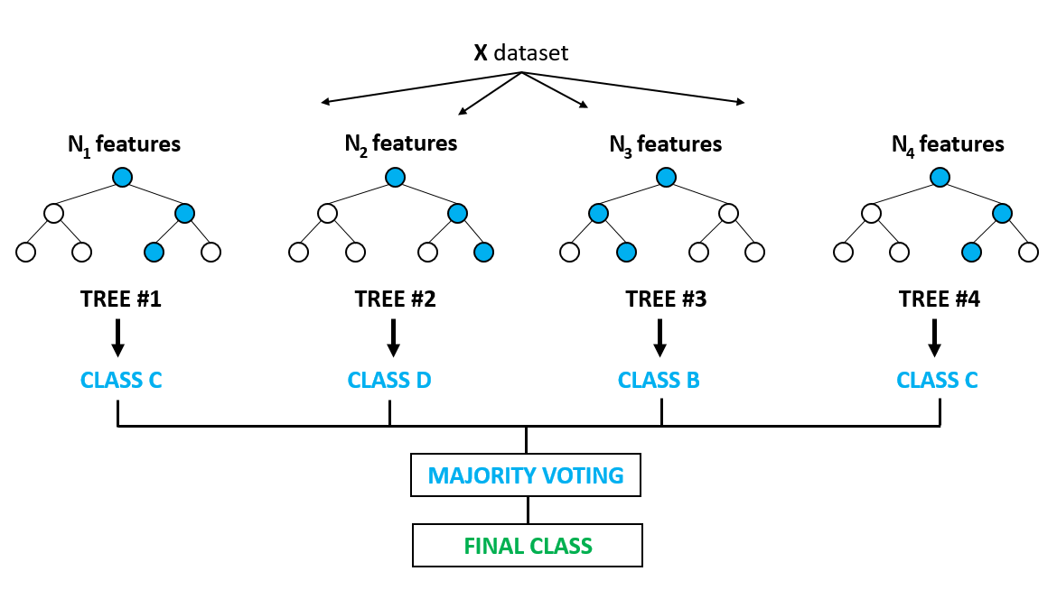
Model Selection
Random Forest- ensemble learning for classification.
Handles correlated variables
Ease of tuning
Strong Predictions
Build RF model from training subset of 2000 data (70%; n=107)
Evaluate performance on test subset of 2000 data (30%; n=46)
Change Typology | Count
Gentrifying | 20 (13%)
Other Change | 133 (77%)

Slide 22
Predictive Variables
Demographics | Housing | Occupational | Transportation | Amenities
% Poverty | % Vacant Land | % Unemployed | % Public Transit Commute | % Park coverage
% Non-Family | % Dwelling 5+ Units | % Blue Collar | % No Car Available | Distance to Downtown
% Aged Under 18 | % Renters |  | % 3+ Cars Available
% Aged Over 65 | % Rent Burdened |  | % Commutes less than 20 min.
 | Eviction Rate
 | Housing Stock Age

Slide 23
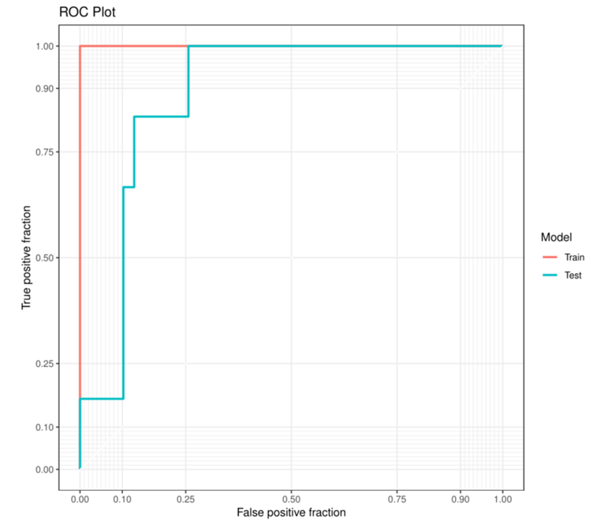
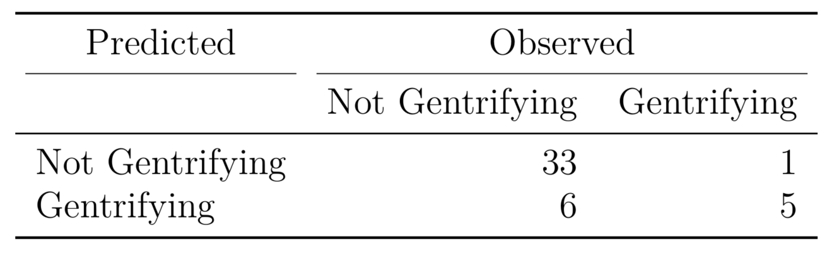
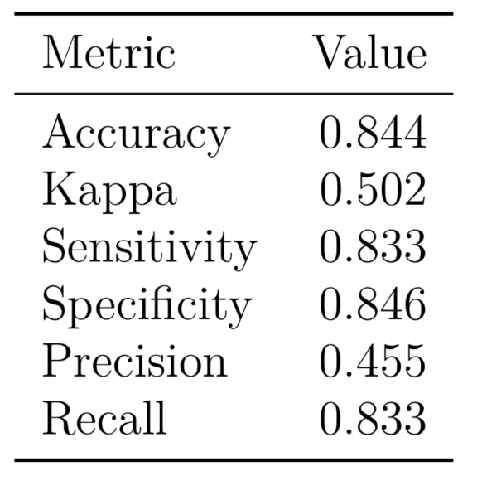
Model Performance
ROC
AUC = .88
True Positive Fraction (Sensitivity)
False Positive Fraction
Notes:
Sensitivity is the model metric we use to select our best model when there is a high cost associated with False Negative.
ROC curve, is a graphical plot that illustrates the diagnostic ability of a binary classifier system as its discrimination threshold is varied.

Slide 24
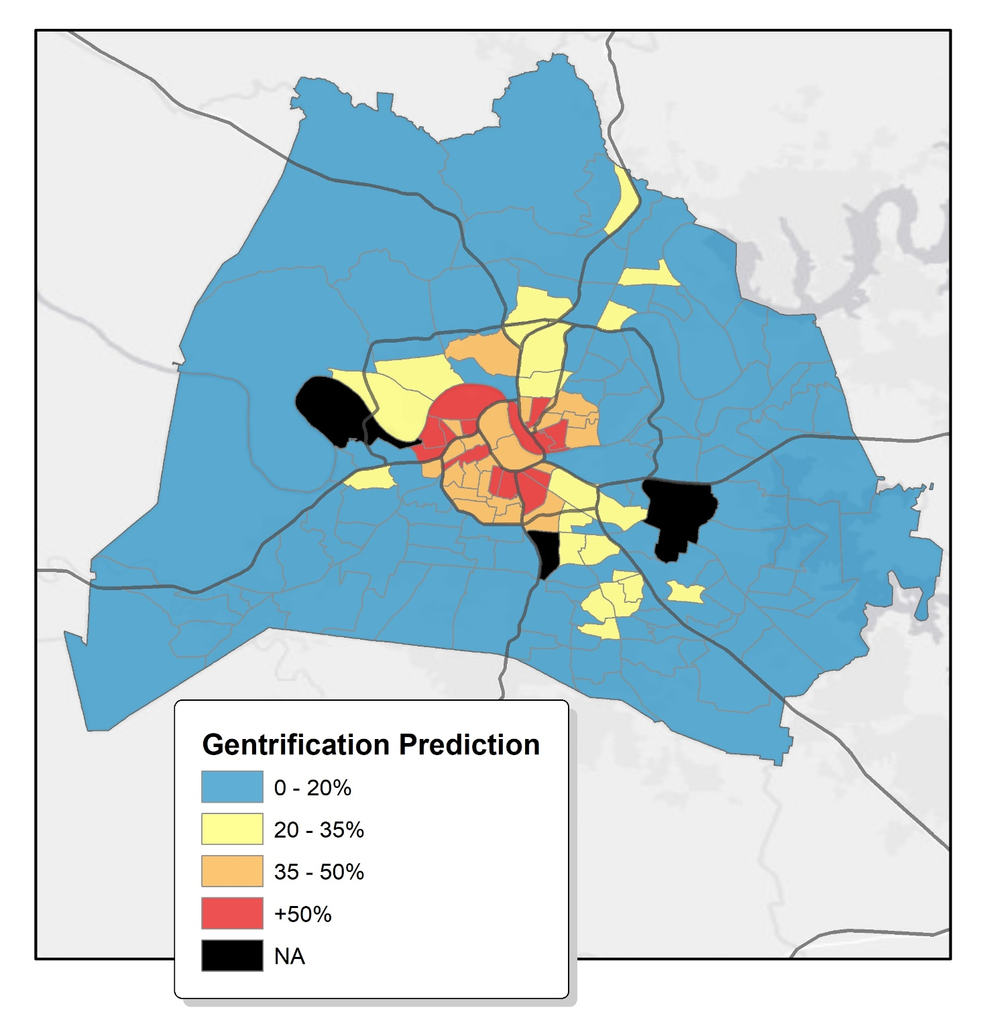
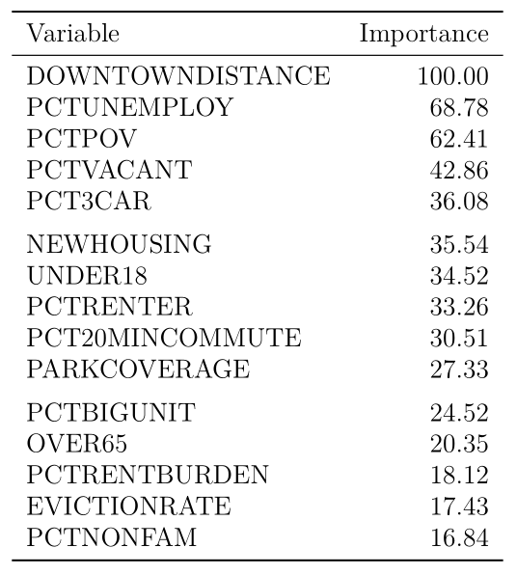
Predictions

Slide 25
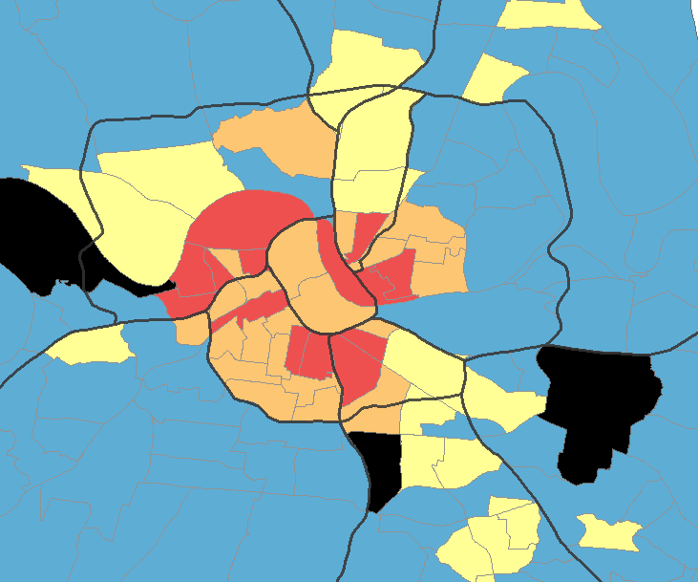
Goal 2
Build a predictive model to identify at-risk areas of future gentrification in Nashville, TN.
Clustering dependent variable >> Train RF model on 2000-2016 data >> Evaluate Performance >> Apply model to 2016 data
Sensitivity = .83; Kappa = .5 (Moderate)
Important Variables = Distance to Downtown, Unemployment, Poverty, Vacancy
Future High-risk Areas:
NE I-440/65 (Cumberland Gardens, Fisk/TSU areas)
Charlotte Ave
South Nashville (Edgehill, 12 South, Berry Hill)
Affordability Corridors (I-65/I-24, Glencliff, Antioch), (I-65/I-24, East Nashville, Madison)
.

Slide 26
Limitations
“Predictions are hard, especially if they’re about the future.”
Reliability of census data
Limited sample size and predictive variables
Variability between model runs
Market disruptions (recessions, transit infrastructure, Brownfields redevelopment, Natural disasters)

Slide 27
Future Work
Other Cities
Spatially Lagged Predictive Variables
Untapped Predictive Variables
Business Locations (Whole Foods vs. Payday loans)
Tax Assessor Data (building quality, bedrooms, bathrooms)
Code Complaints/Violations
Notes:
Increase Precision

Slide 28

Acknowledgements
A sincere thank you to…
Committee Members: Dr. Jonathan Gilligan, Dr. Janey Camp, Dr. Larisa DeSantis
Funding: Vanderbilt Initiative for Smart-City Operations Research (VISOR)
Support: EES graduate students and staff

